Slide 1
Here are the 2 books download links
S520 Standard for Professional Mold Remediation (2015) ePub
https://production-v3.editionguard.com/fulfillment/dtqWekudmn
S500 Standard for Professional Water Damage Restoration (2021) ePub
https://production-v3.editionguard.com/fulfillment/HxhQJV9HAW

Slide 2
Download adobe digital edition
https://www.adobe.com/solutions/ebook/digital-editions/download.html
Install this small application then authorized the computer

Slide 3
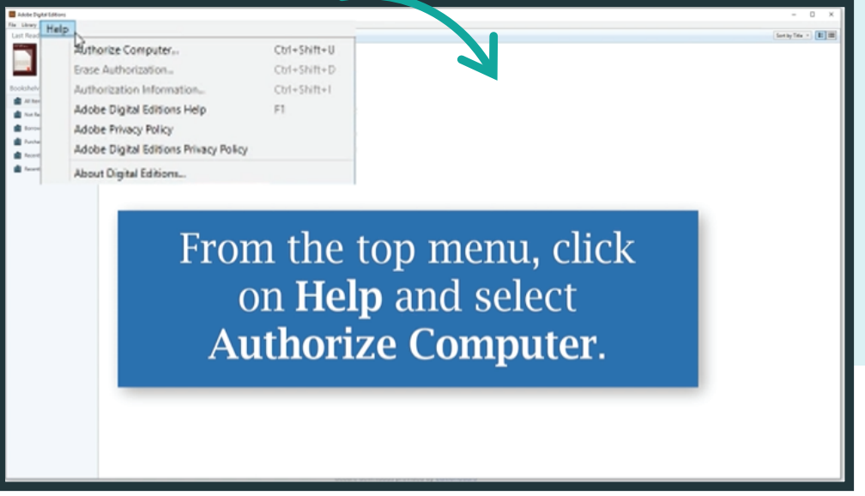
Click on help menu and choose authorized computer option
See the next slide screenshot for reference

Slide 4
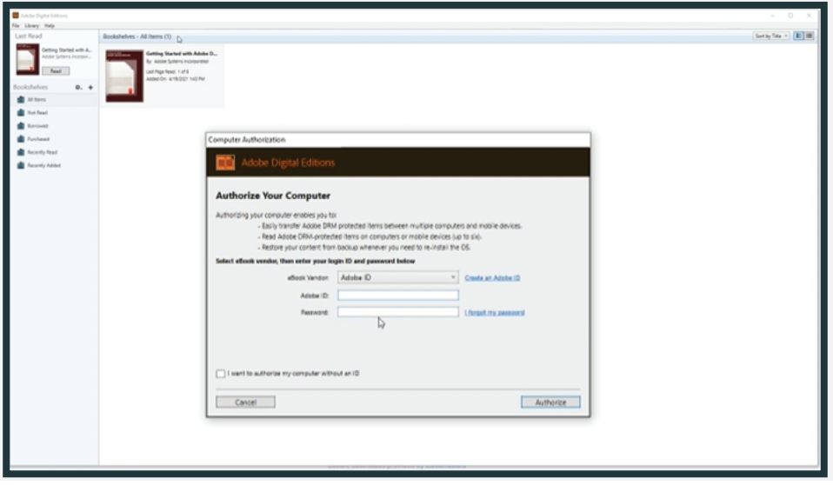
Put the below credentials for activation
Email: akhan@ecrpro.com
Pass: Packout@786

Slide 5
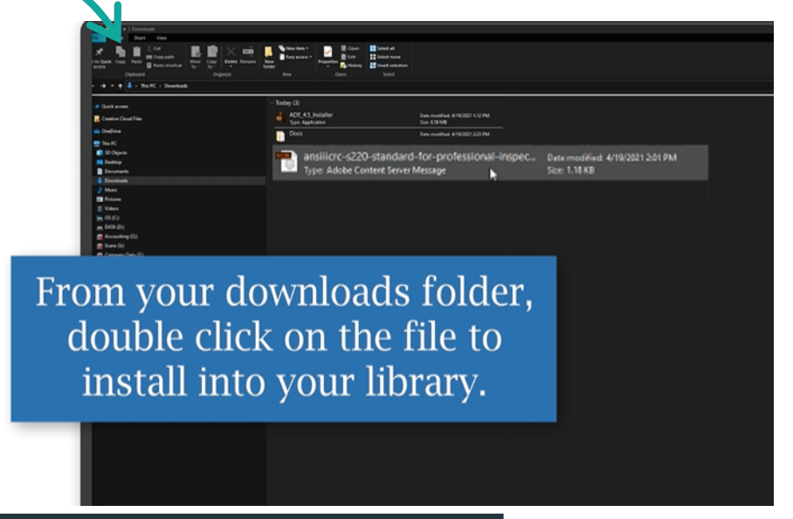
Now click on downloaded file it will open in the adobe digital reader automatically

Slide 6
IOS App
https://itunes.apple.com/us/app/adobe-digital-editions/id952977781?mt=8
Andriod App
https://play.google.com/store/apps/details?id=com.adobe.digitaleditions

Slide 7
This is strictly copyright and protected, so in phone I am unable to take
Screenshots, as its not allowing to share anything publically

