Slide 1
Ring Central ECRPRO 562 735 4966

Slide 2
Login Access
https://service.ringcentral.com/
User: 5627354966 Pass: Packout@786
Pin: 56405640
Pet Name: horse

Slide 3
Join Meeting / Start Meeting https://v.ringcentral.com/join/399943664
Join From Telephone:
Dial In: +17732319226
Participant Access: 399943664
Host Access: 346508921

Slide 4
Training Videos / Guides http://learn.ecrpro.com/ringcentral-videos.htm
Web Login
http://app.glip.com/
Desktop App
https://app.ringcentral.com/download/RingCentral.exe
Andriod App
https://play.google.com/store/apps/details?id=com.glip.mobile&hl=en_US
IOS App
https://apps.apple.com/us/app/id715886894

Slide 5
aimINSIGHT Solutions, Inc. Staff Logins
https://app.glip.com/
Shella Mapendan
User: 3107348830@aiminsight.com
Pass: @1m1n$1ght
Ext: 101
Leon Haseeb
User: 9207868898@aiminsight.com
Pass: @1m1n$1ght
Ext: 104
Carlos User: 3109336460@aiminsight.com
Pass: @1m1n$1ght
Ext: 113
Abdul Basit User: abdulbasit565@yahoo.com
Pass: @1m1n$1ght
Ext: 109
AJ Amjad User: amjad@aiminsight.com Pass: @1m1n$1ght
Ext: 110
Imtiaz User: imtiaz@aiminsight.com
Pass: @1m1n$1ght Ext: 105
Fred Chugtai
User: 3108789329@aiminsight.com
Pass: @1m1n$1ght
Ext: 102

Slide 6
aimINSIGHT Solutions, Inc. Staff Logins
https://app.glip.com/
Support
supportext@aiminsight.com
@1m1n$1ght
ext 103
Sales
salesext@aiminsight.com
@1m1n$1ght
ext 106
Billing
billing@aiminsight.com
@1m1n$1ght
ext 107
Payable
payable@aiminsight.com
@1m1n$1ght
ext 108

Slide 7
Exclusively Contents, Inc. Staff Logins https://app.glip.com/
Melissa
User: 3108768122@ecrpro.com
Pass: Packout@786
Ext: 604
Essel
User: 639173028571@ecrpro.com
Pass: J@bs2@21
Ext: 605
Khurram Ahmed
User: 3109841093@ecrpro.com
Pass: Packout@786
Ext: 602
Zamira
User: 5625063103@ecrpro.com
Pass: Packout@786
Ext: 607
AJ Amjad User: akhan@ecrpro.com
Pass: Packout@786
Ext: 910
Imtiaz User: ikhan@ecrpro.com
Pass: Packout@786
Ext: 905
Lorena
User: 5623596413@ecrpro.com
Pass: Packout@786
Ext: 608
Vaughn
User: vsigmon@ecrpro.com
Pass: Packout@786
Ext: 614

Slide 8
Exclusively Contents, Inc. Staff Logins https://app.glip.com/
Noe Cruz
User: 5623596398@ecrpro.com
Pass: Packout@786
Ext: 603
Jeremy Barnes
User: 5623596416@ecrpro.com
Pass: Packout@786
Ext: 606
Jim Orem
User: 5623596396@ecrpro.com
Pass: Packout@786
Ext: 701
Evangelina
User: 5623596414@ecrpro.com
Pass: Packout@786
Ext: 610
Oscar
User: 5623596432@ecrpro.com
Pass: Packout@786
Ext: 613

Slide 9
Exclusively Contents, Inc. Department Logins https://app.glip.com/
Adjusters
User: adjusters@ecrpro.com
Pass: Packout@786
Ext: 615
Clients
User: clients@ecrpro.com
Pass: Packout@786
Ext: 616
Contractors
User: contractors@ecrpro.com
Pass: Packout@786
Ext: 617
Storage
User: storage@ecrpro.com
Pass: Packout@786
Ext: 618
Accounts Receivable
User: accountsreceivable@ecrpro.com
Pass: Packout@786
Ext: 619
Accounts Payable
User: accountspayable@ecrpro.com
Pass: Packout@786
Ext: 620

Slide 10
Old IVR System Call Queues

Slide 11
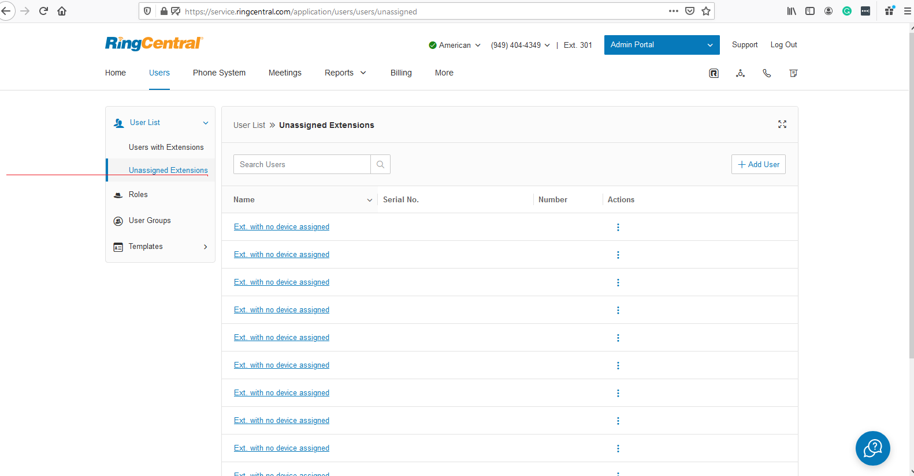
Get new extension from here for new user

Slide 12
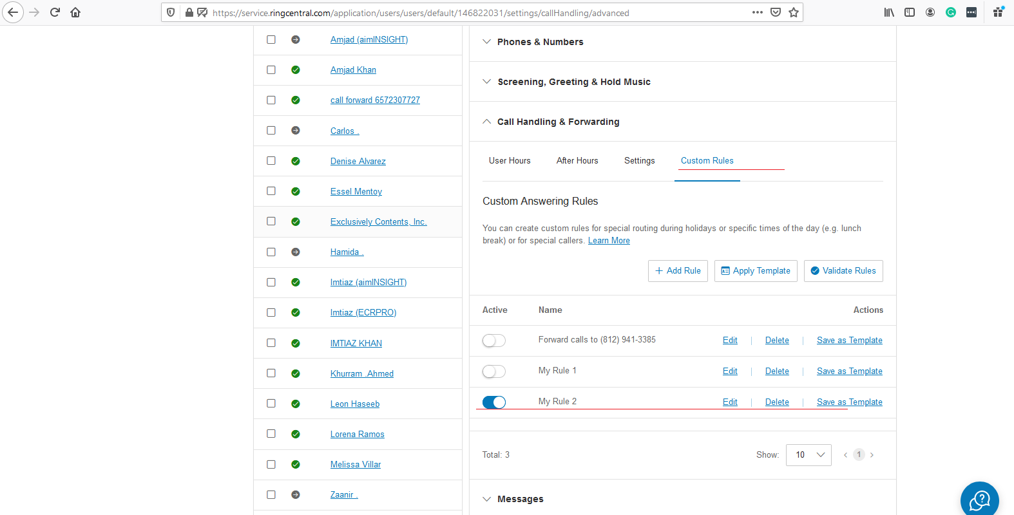
Customer rule setup for call handling

Slide 13
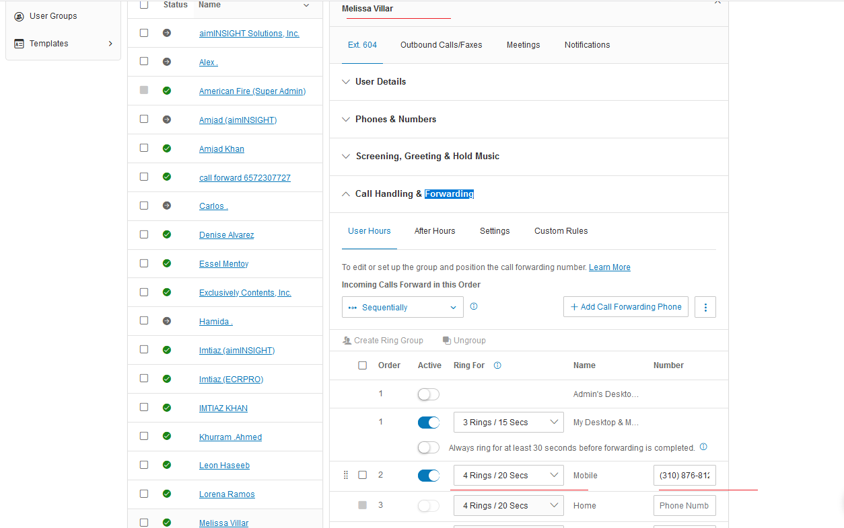
User call handling phone no. setup, if not taking extensions call thenforwarded to cell no.

Slide 14
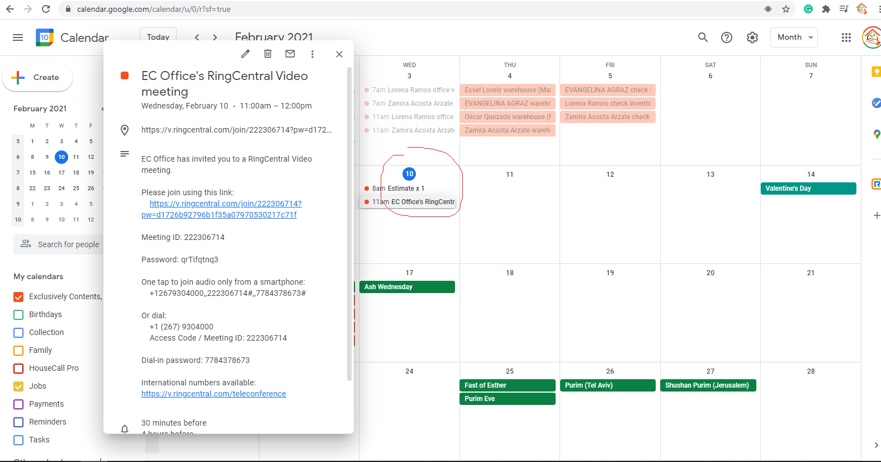
Video meeting schedule with jobsecrpro@gmail.com calendar

Slide 15
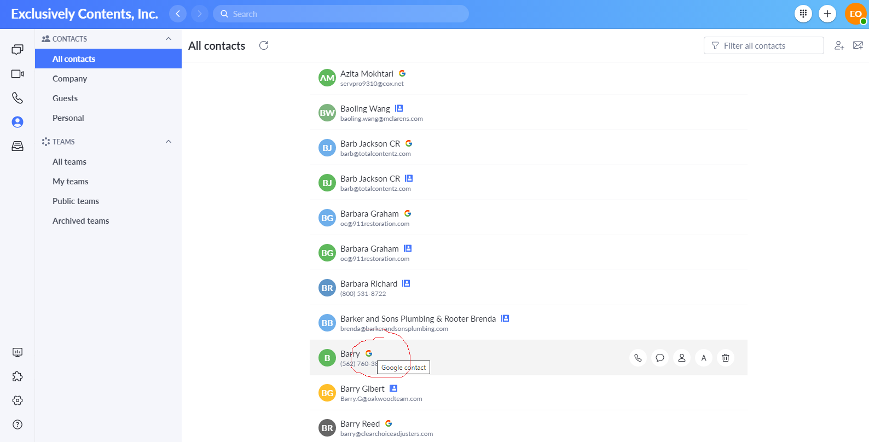
Google contact sync

Slide 16
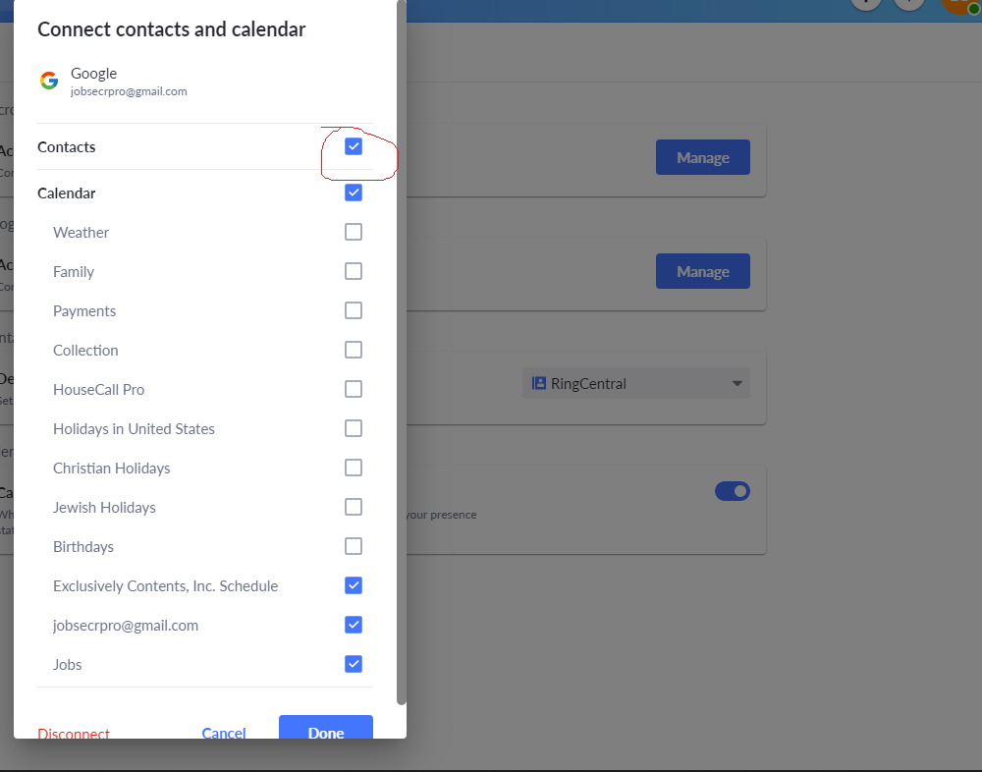
Google contact sync permission in calendar integration settings

Slide 17
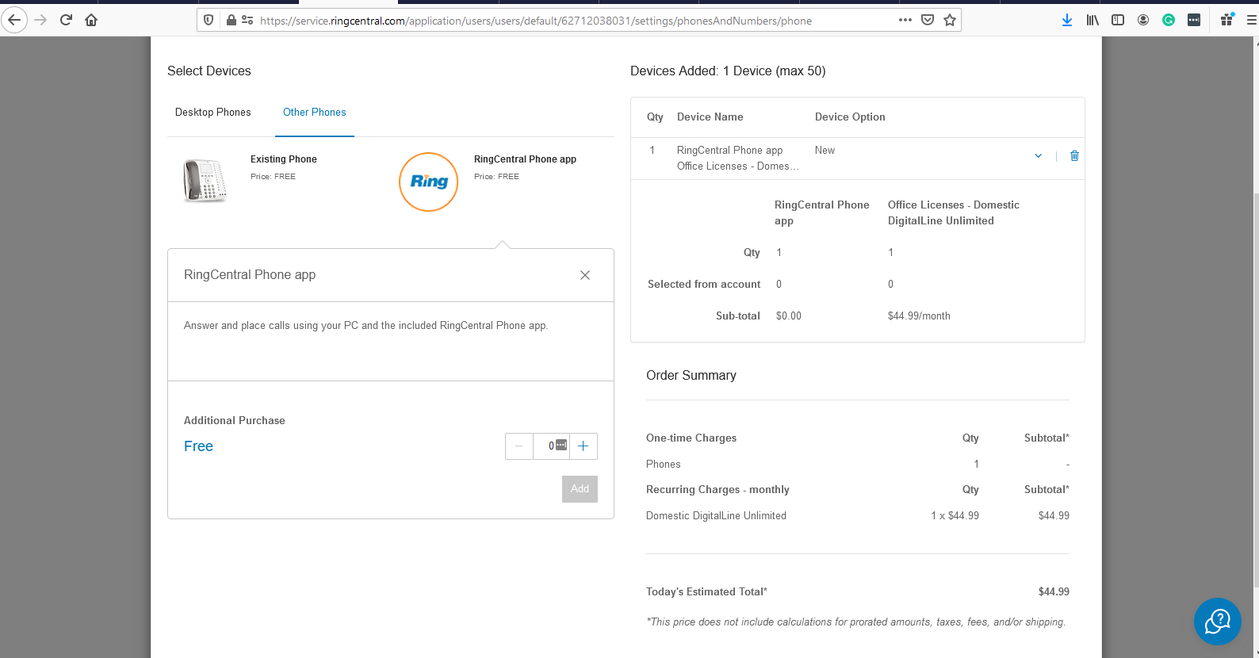
For all users need to buy 9 digital lines $44 each, for sending SMS to everywhere in US

Slide 18
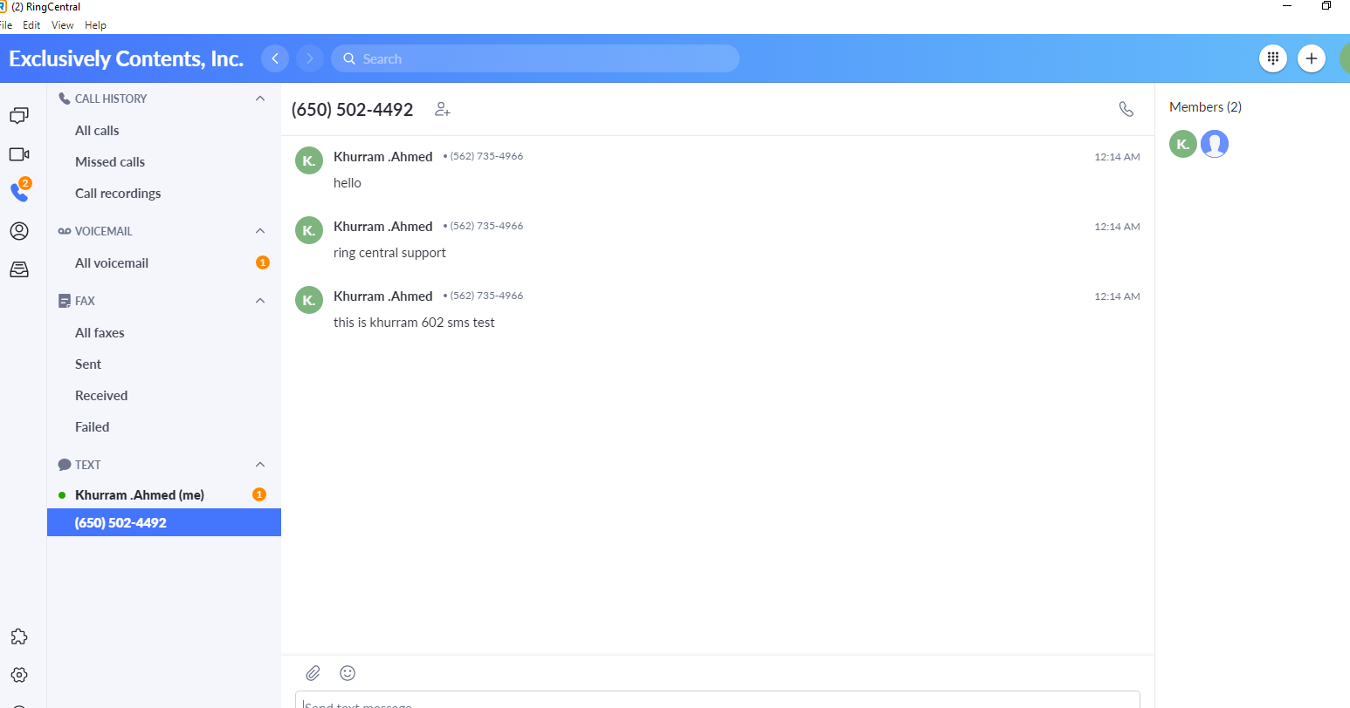
SMS setting setup on 602 user (khurram) and it words outside ringcentral

Slide 19
New IVR System Press Key

Slide 20
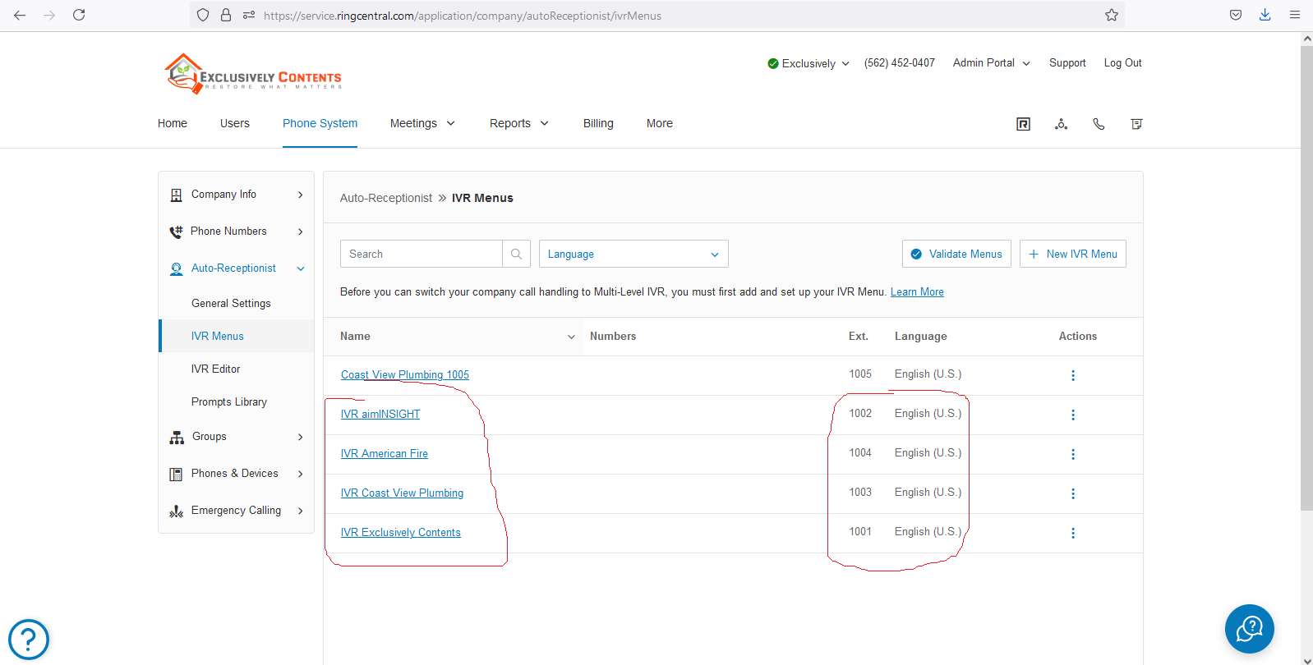
This is the IVR system for transferring calls to extension and no. https://service.ringcentral.com/application/company/autoReceptionist/ivrMenus

Slide 21
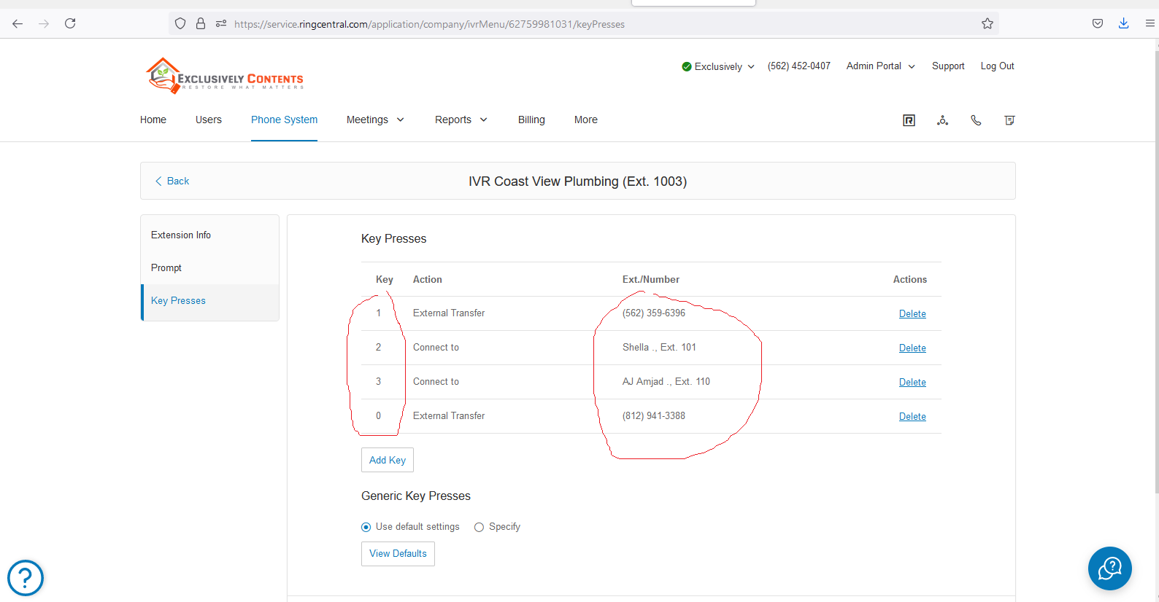
These keys are need to assign with extensions

Slide 22
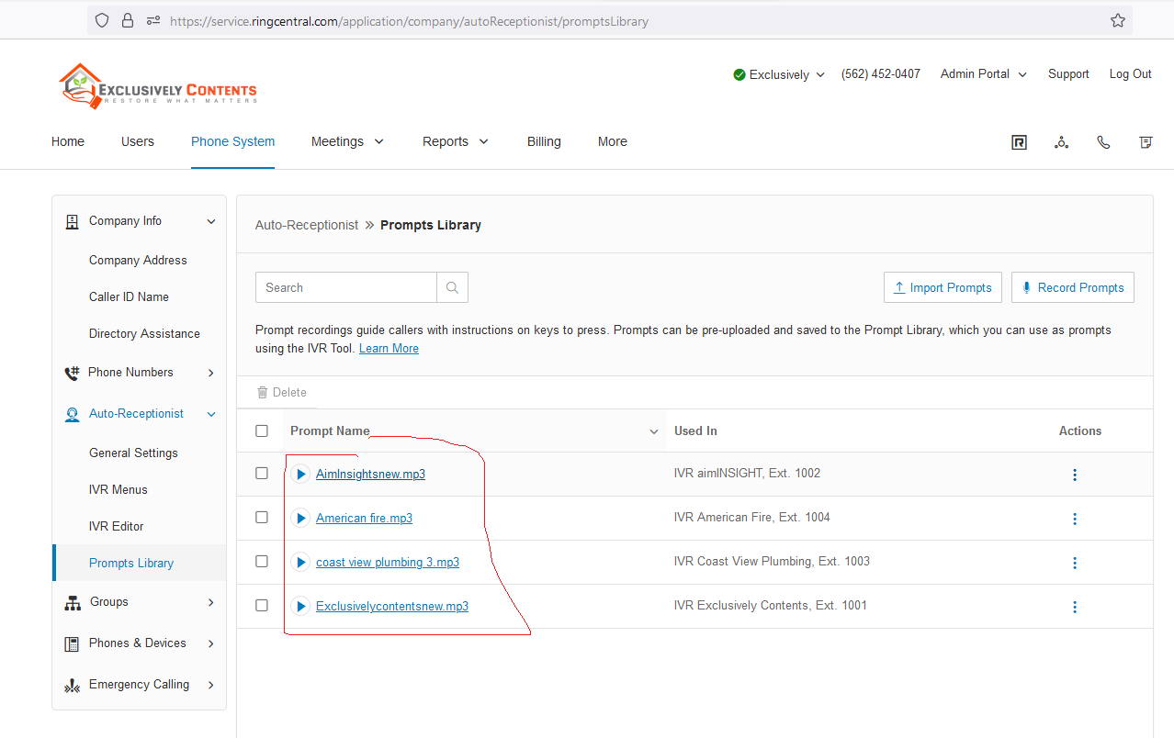
Prompt Library
https://service.ringcentral.com/application/company/autoReceptionist/promptsLibrary

Slide 23
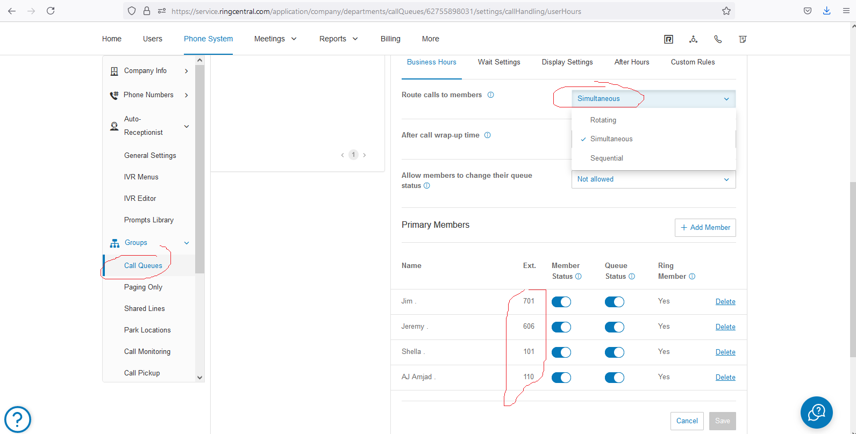
Call Queues group does not support external no. like metro, it works only with extension

Slide 24
Features
Replace voxer for job communication, all team members do a chat here in ring central app
Replace clicksend for sms, sent sms to any vendor / customer from ring central account

Slide 25
Ring Central Voicemail Recording Steps

Slide 26
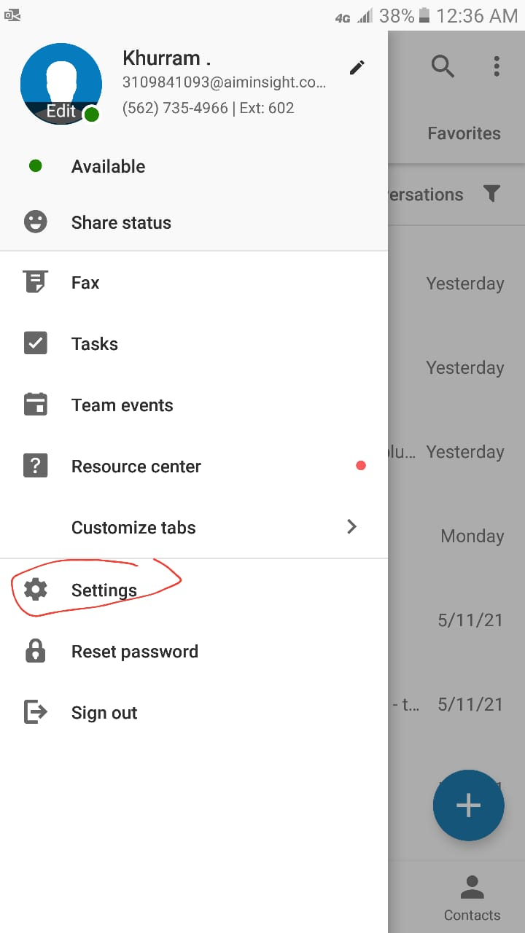
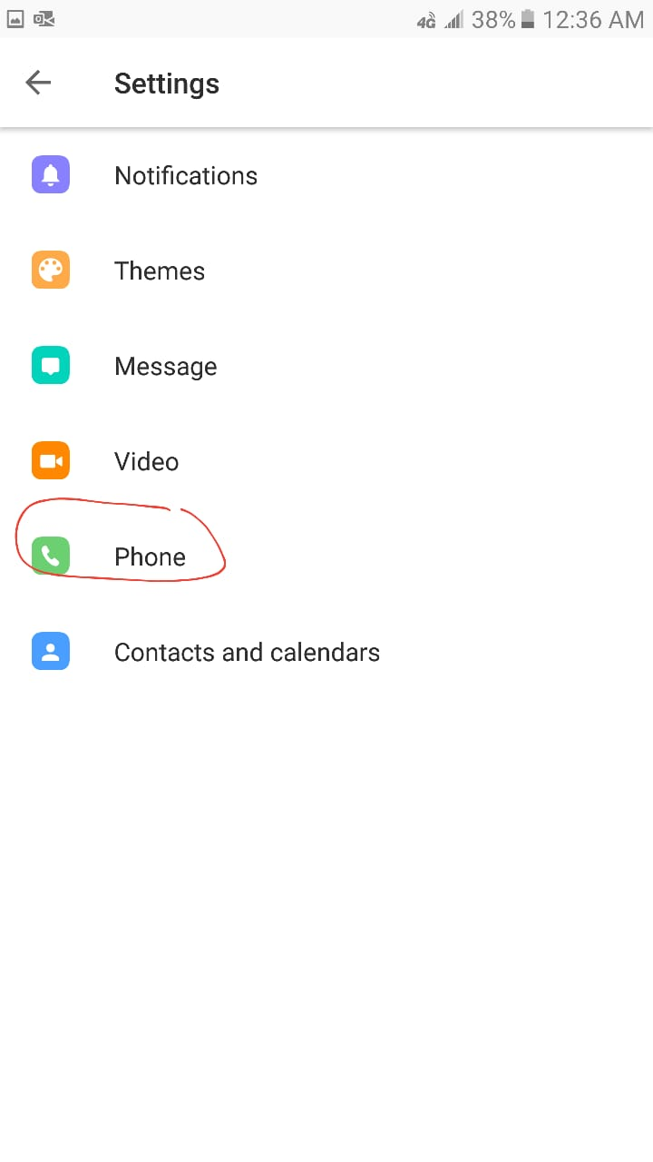
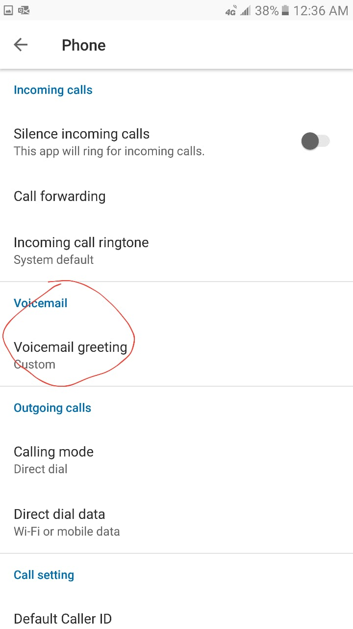

Slide 27
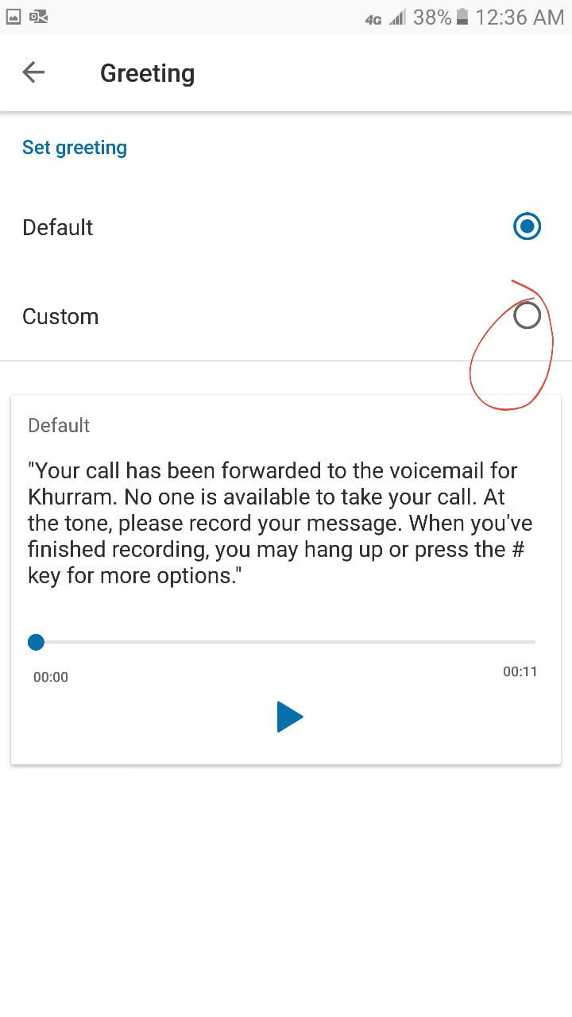
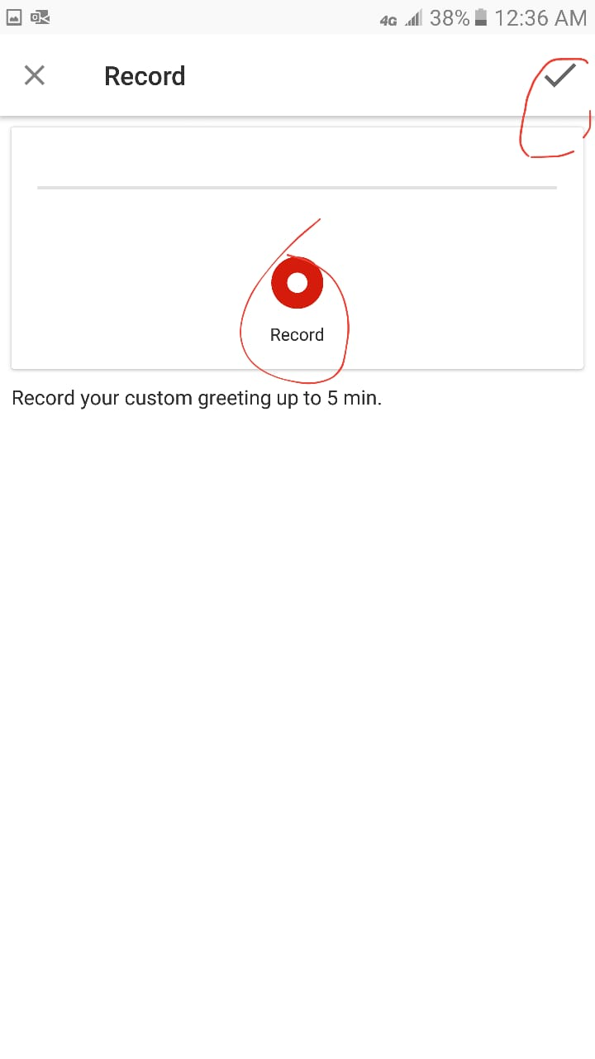

Slide 28
Voicemail By Pass press #
Press # sign for not to listen complete voicemail recording again and again
After press # it immediately start voicemail recoding if user not available to take call

