Slide 1
In person Docusign

Slide 2
Links
https://support.docusign.com/en/articles/PowerForms-vs-Templates
https://support.docusign.com/en/articles/Why-is-Sign-in-Person-recipient-action-not-supported-with-PowerForms
https://support.docusign.com/articles/In-Person-Signing-with-the-DocuSign-Mobile-App-for-iOS-iPad-iPhone-iPod-Touch
https://support.docusign.com/guides/ndse-user-guide-in-person-signing
https://support.docusign.com/articles/In-Person-Signing-with-the-DocuSign-Mobile-App-for-Windows
https://support.docusign.com/articles/In-Person-Signing-with-the-DocuSign-Mobile-App-for-Android

Slide 3
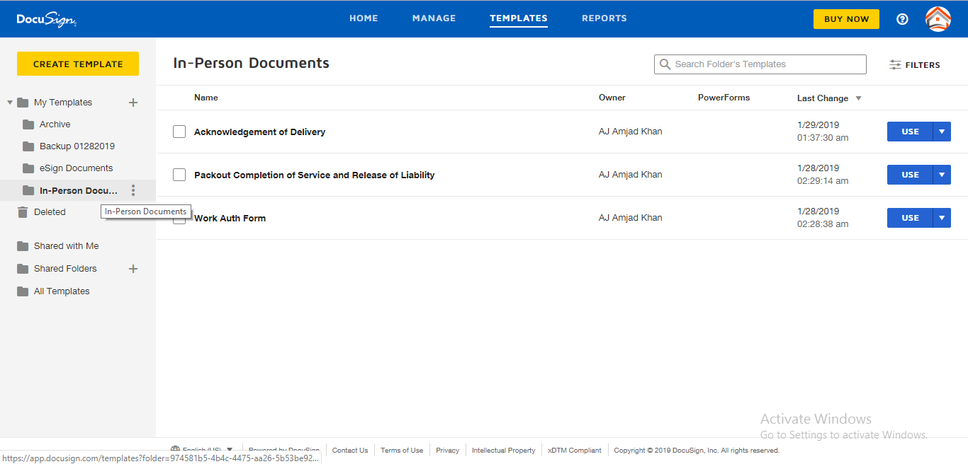
Left side documents created of In-person, choose the document

Slide 4
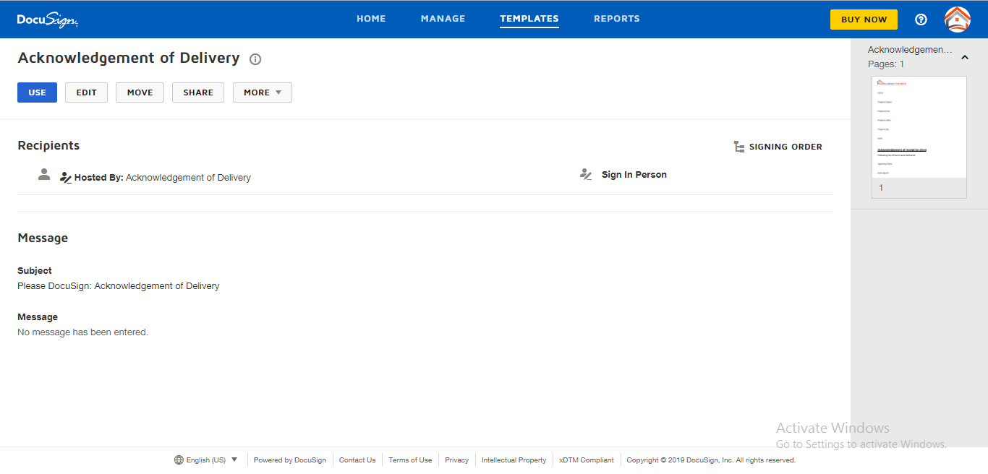
Here you can choose use option to proceed

Slide 5
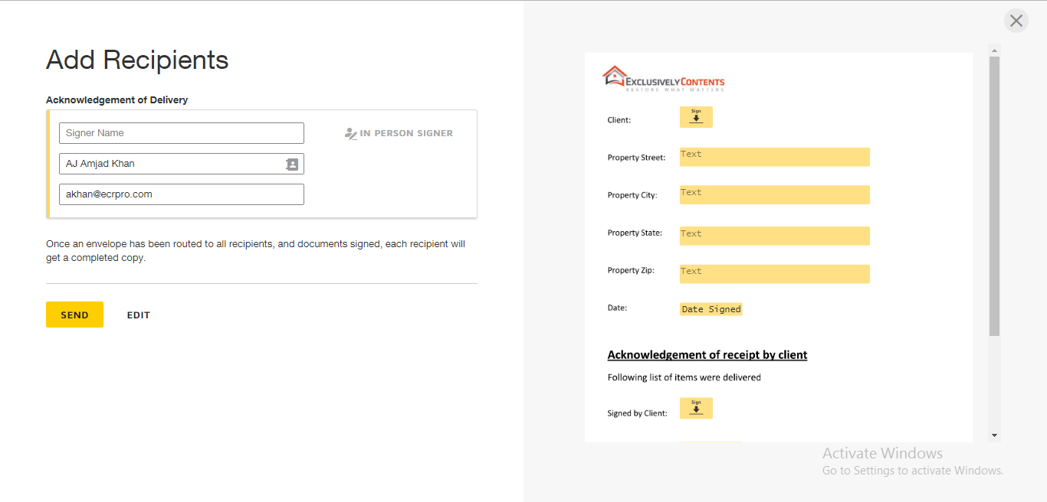
Here you can choose registered users by clicking in user icon on username and send it

