Slide 1
REO Camera

Slide 2
Reolink userid: admin password:5640pack
Admin 5640pack
Luis 5640pack
Amjad 5640pack
Leon 5640pack
Khurram 5640pack
Melissa 5640pack
Tyana 5640pack
Shella 5640pack
Sammy 3103pack
UID: 952700009VVAA767

Slide 3
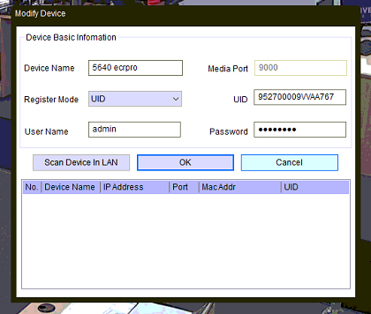

Slide 4
